Slide 1
Estimation of blood glucose
Clinical laboratory training
Lec. Dhuha fadhil
MSC clinical biochemistry
BSC pharmacy

Slide 2
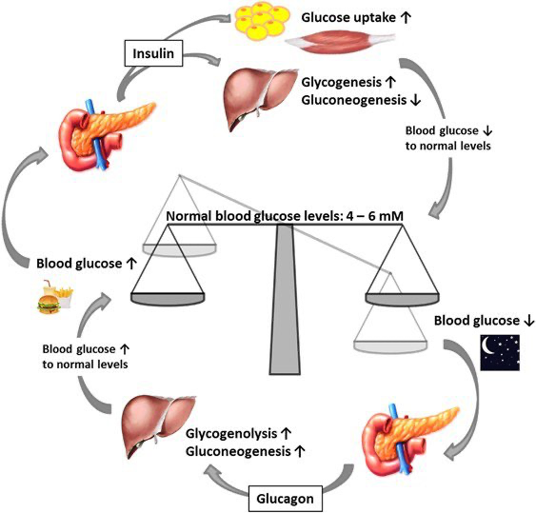
Glucose homeostasis

Slide 3
Glucose homeostasis
Hormones' involved :
Insulin ↑
Glucagon ↓
Growth hormone↓
Adrenalin ↓
Cortisol↓

Slide 4
Insulin actions

Slide 5
Blood Glucose
Normal values
Random plasma glucose | N/A
Fasting plasma glucose (FPG) | < 100 mg/dl (5.6 mmol/L)
2-hour plasma glucose during OGTT | <140 mg/dl (7.8 mmol/L)
Hemoglobin A1c | <5.7%

Slide 6
Diabetes Mellitus
Metabolic disorder characterised by high blood glucose level

Slide 7
Abbreviations
DM | Diabetes mellitus
FPG | Fasting plasma glucose
OGTT | Oral glucose tolerance test
A1C | Glycated hemoglobin
2-h PG | 2-h Plasma glucose concentration
GDM | Gestational diabetes mellitus
DKA | diabetic ketoacidosis
HONK | Hyperosmolar non-ketotic coma

Slide 8
Diagnostic criteria (ADA)
Criteria for the diagnosis of diabetes
If hyperglycemia well established, diagnosis requires two abnormal test results from the same sample or in two separate test samples.
FPG ≥126 mg/dL (7.0 mmol/L). Fasting is defined as no caloric intake for at least 8 h. OR
2-h PG ≥200 mg/dL (11.1 mmol/L) during OGTT. (glucose of 75 g dissolved in water). OR
A1C ≥6.5% (48 mmol/mol). OR
In a patient with classic symptoms of hyperglycemia or hyperglycemic crisis, a random plasma glucose ≥200 mg/dL (11.1 mmol/L).
Notes:
The test should be performed as described by WHO, using a glucose load containing the equivalent of 75 g anhydrous glucose dissolved in water.*

Slide 9
Increased Risk for Diabetes (Prediabetes)
Prediabetes
Random plasma glucose | N/A
FPG | 100-125 mg/dl (5.6-6.9 mmol/L)
2-h OGTT | 140-199 mg/dl (7.8-11.0 mmol/L)
A1c | 5.7%-6.4%

Slide 10
Test | Normal Range | Increased Risk for Diabetes (Prediabetes) | Diabetes
Random plasma glucose | NA | NA | ≥ 200 mg/dl (11.1mmol/L) +Symptoms of DM or hyperglycemic crisis
Fasting plasma glucose | < 100 mg/dl (5.6 mmol/L) | 100-125 mg/dl (5.6-6.9 mmol/L) | ≥ 126 mg/dl (7.0 mmol/L)
2-hour plasma glucose during an OGTT | <140 mg/dl (7.8 mmol/L) | 140-199 mg/dl (7.8-11.0 mmol/L) | ≥ 200 mg/dl (11.1 mmol/L)
Hemoglobin A_{1c} | <5.7% | 5.7%-6.4% | ≥ 6.5%

Slide 11
Oral glucose tolerance test (OGTT)
In Equivocal cases OGTT is required for the diagnosis
An OGTT is usually performed after an overnight fast (for at least 8 hr. but not more than 16 hr.). A standard dose of 75 g of anhydrous glucose in 300 ml of water is given by mouth over a 5 minutes period. Blood specimens are collected before giving the glucose load and after 2 hr.

Slide 12
Gestational Diabetes
hyperglycemia during the second or third trimester
All pregnant women should be screened for GDM between 24-28 weeks of gestation (o'sullivan screening test)
Women with high risk of GDM (who?) should be screened earlier and rescreened at 24-28 W
FPG ≥126 mg/dL (7.0 mmol/L) &a random plasma glucose ≥200 mg/dL (11.1 mmol/L) indicates GDM
Notes:
Women at high risk for GDM include those who have had GDM before, have previously given birth to a high-birthweight baby, are obese, have a family history of diabetes mellitus and/or are from high-risk ethnic groups, for example black or South Asian.

Slide 13
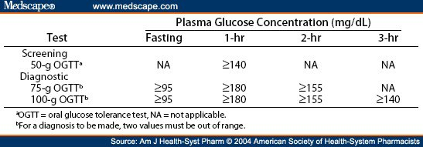

Slide 14
Monitoring of DM
Glycosuria
Blood glucose
Glycated hemoglobin
Fructosamine
Blood ketones

Slide 15
Glycated hemoglobin (A1C)
AIC
Mean plasma glucose
RBC lifespan
It measures the average blood glucose level during the preceding 6-8 weeks .

Slide 16
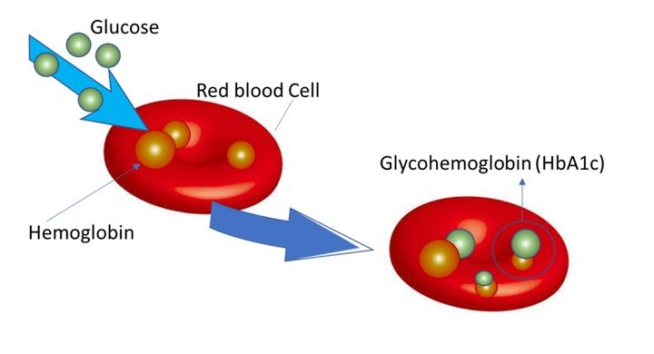
Glycated hemoglobin (A1C)
Notes:
Glycated hemoglobin (HbA1c) is formed by non-enzymatic glycation of hemoglobin and is dependent on the mean plasma glucose concentrations and on the lifespan of the red cells; falsely low values may be found in patients with hemolytic disease.

Slide 17
Notes:
HbA1c is expressed as a percentage of total blood hemoglobin concentration and gives a retrospective assessment of the mean plasma glucose concentration during the preceding (6-8 weeks).

Slide 18
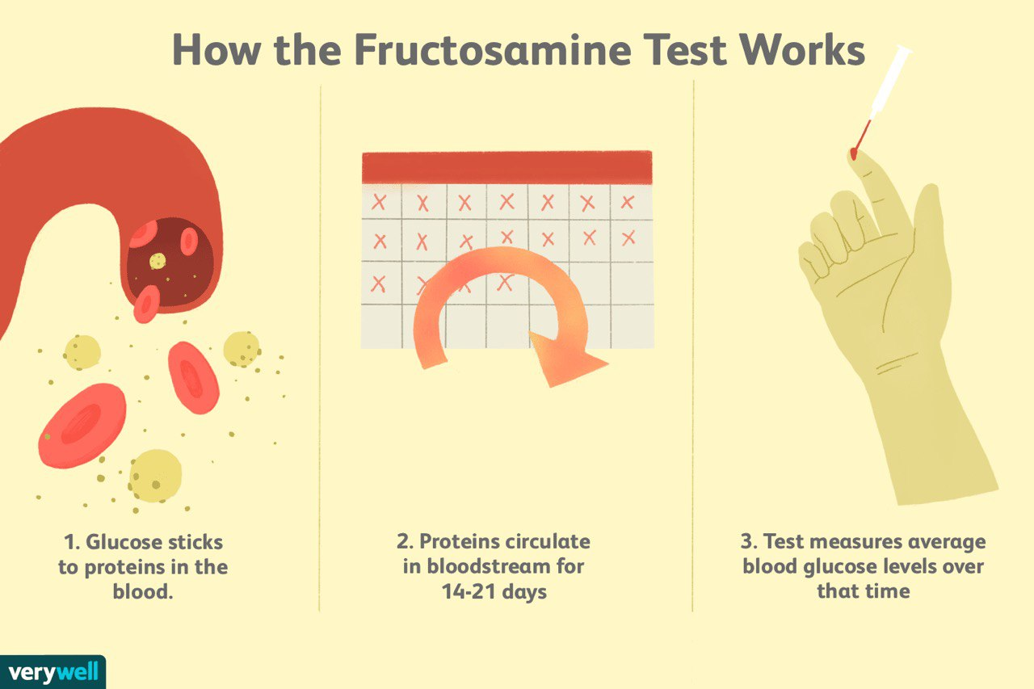
Notes:
Fructosamine reflects glucose bound plasma proteins, predominantly albumin, which has a plasma half-life of about 20 days but is problematic in patients with hypoalbuminemia. This assay may sometimes be useful in pregnancy and hemolytic disease (in whom HbA1c is difficult to measure and interpret).
The measurement of plasma fructosamine concentrations may be used to assess glucose control over a shorter time course than that of HbA1c (about 2-4 weeks), but the assay has methodological limitations

Slide 19
Glycosuria
If plasma glucose concentration > 180 mg/dl (10.0 mmol/L) (renal threshold)→→→Glycosuria
Glycosuria may be due to:
• diabetes mellitus,
• a glucose-containing infusion,
• renal glycosuria, which may be inherited as an autosomal dominant trait or in Fanconi's syndrome,
• pregnancy.
Note: the presence or absence of glycosuria has no role in the screening or diagnosis of DM.

Slide 20
Ketones in urine or blood: ketone bodies = (acetone +acetoacetate and β-hydroxybutyrate)
found in
uncontrolled diabetes type I (diabetic ketoacidosis, DKA).
starvation or fasting
alcoholic patients with poor dietary intake (alcoholic ketoacidosis).

Slide 21
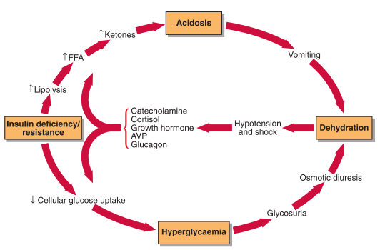
Diabetic ketoacidosis ( DKA)

Slide 22
Hyperosmolar non-ketotic coma (HONK)
mostly in elderly, Type 2 diabetics
The level of insulin is sufficient to prevent ketosis but does not prevent hyperglycaemia and osmotic diuresis
Precipitating factors include severe illness, dehydration, glucocorticoids, diuretics, parenteral nutrition, dialysis, and surgery.

Slide 23
DKA VS HONK
DKA
HONK
Hyperglycemia
Ketotic
Metabolic acidosis
Hyperglycemia
High serum osmolality
Absence of significant acidosis

Slide 24
Glucose estimation
Principle: (Enzymatic method)
Glucose is oxidized by glucose oxidase to gluconate and hydrogen peroxide according to the following equation:

Slide 25
Glucose estimation
Sample:
Serum (not hemolyzed)
Plasma
Spinal fluid
Note: Sodium fluoride ions (gray-top tubes) are often used as an anticoagulant and preservative of whole blood to prevent glycolytic enzymes, particularly if analysis is delayed.

Slide 26
Glucose estimation
Interfering factors:
Stress
Smoking
Alcohol
Medication e.g.: diuretics, anticonvulsants, oral contraceptives, and corticosteroids.
Exercise.

Slide 27
Glucose estimation
Procedure:
 | Blank | Standard | Sample
Standard | ------------- | 10 μl | --------------
Sample | ------------- | ------------- | 10 μl
Working reagent | 1ml | 1ml | 1ml

Slide 28
References
Clinical biochemistry and metabolic medicine by Martin A crook
American Diabetes Association

